Slide 1

Human Development
PSY 101, BRAC University
Monzia Mushtaq

Slide 2
As we journey through life—from womb to tomb—when and how do we develop?
Virtually all of us began walking around age 1 and talking by age 2.
As children, we engaged in social play in preparation for life’s work. As adults, we all smile and cry, love and loathe, and occasionally ponder the fact that someday we will die.
Developmental psychology examines how people are continually developing— physically, cognitively, and socially—from infancy through old age.

Slide 3
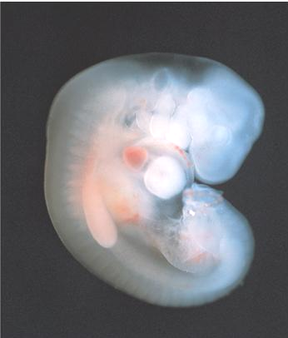
Prenatal Development
The Zygote Stage: First 10 to 14 Days
After the nuclei of the egg and sperm fuse, the cell divides in 2, 4, 8, 16, 100, 1000…
Milestone of the zygote stage: cells begin to differentiate into specialized locations and structures
Implantation: The Embryo, 2 to 8 weeks
This stage begins with the multicellular cluster that implants in the uterine wall.
Milestone of the implantation stage: differentiated cells develop into organs and bones
Embryo
Notes:
Click to reveal bullets.
Instructor: You can ask students if they think that teratogens qualify as a “nurture” factor influencing development. If we recall that “nurture” really means “environmental influences” and not “cuddling,” it should be clear that this is an example of how nature and nurture both operate before birth.
Sometimes, the zygote first fully splits into two; this is the start of identical twins.
The outer layer of cells becomes the placenta, the mechanism for providing nutrients and oxygen to the child and filtering out toxins; it will be more visible on the next slide.
At nine weeks, hands and face have developed; the embryo is now called a fetus (“offspring”). At 4 months, many more features develop.
Milestone of the fetal stage: by six months, the fetus might be able to survive outside the womb

Slide 4


Fetal Life: The Dangers
Dangers
Teratogens (“monster makers”) are substances such as viruses and chemicals that can damage the developing embryo or fetus.
Fetal Alcohol Syndrome (FAS) refers to cognitive, behavioral, and body/brain structure abnormalities caused by exposure to alcohol in the fetal stage.
Notes:
Click to reveal bullets.
Examples of noticeable problems in FAS: hyperactivity, learning problems, emotion control problems, and unusual facial size, shape, and features. The underlying problem of FAS may be that alcohol switches genes on and off, diverting the normal course of development.

Slide 5

Fetal life: Responding to Sounds
Fetuses in the womb can respond to sounds.
Fetuses can learn to recognize and adapt to sounds that they previously heard only in the womb.
Fetuses can habituate to annoying sounds, becoming less agitated with repeated exposure.
Notes:
Click to reveal bullets.
Evidence of learning to recognize sounds from inside the womb: immediately after birth, newborns prefer mother’s voice, and even coo and cry in the tones of her language.
Evidence of habituating to annoying sounds: after birth, newborns can ignore sounds that would agitate other newborns.

Slide 6
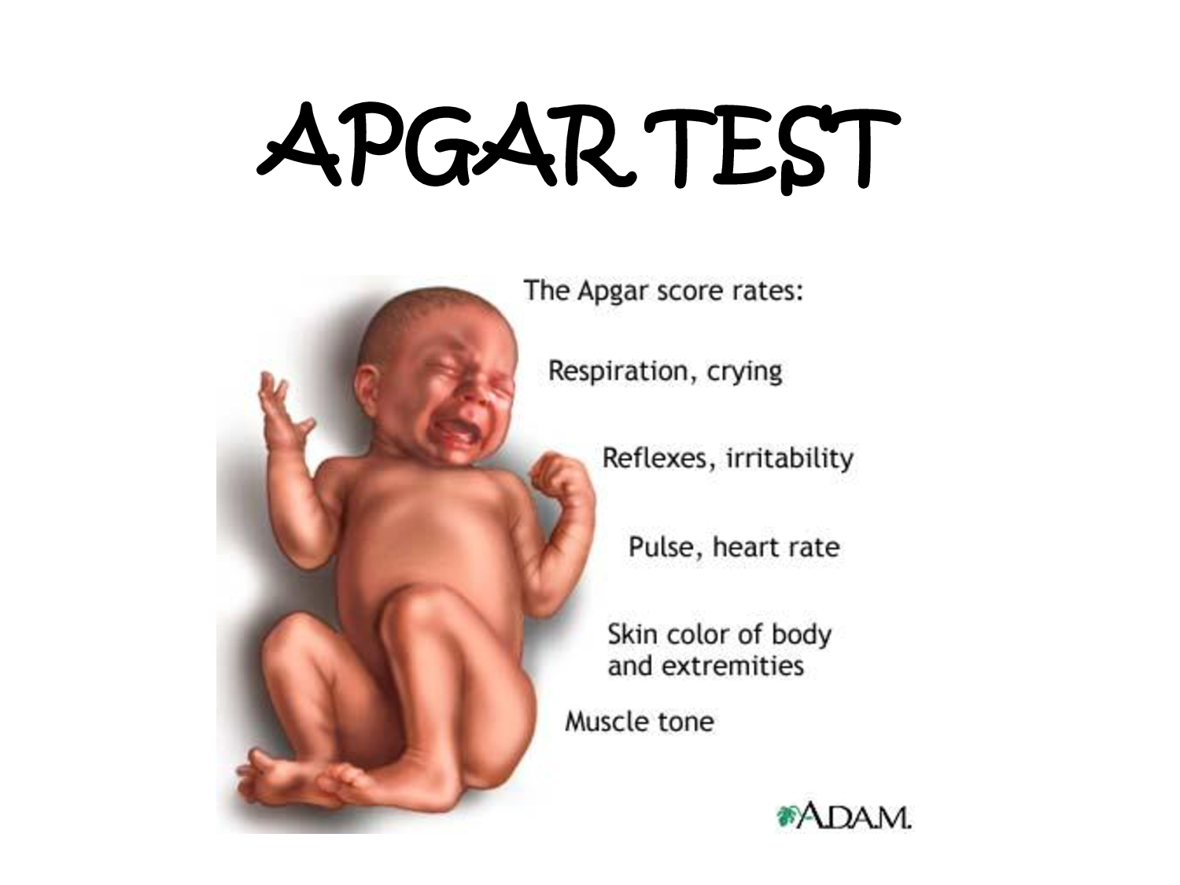
The APGAR Test
A quick, physical test Given to every newborn at birth
At 1 minute, 5 minutes after birth
A score of 7-10 is considered normal,
4-6 might need resuscitation
Lower than 3 requires immediate resuscitation
A=Activity or muscle tone
P=Pulse
G=Grimace or reflex irritability
A=Appearance (skin tone)
R=Respiration
Notes:
Click to reveal bullets.
Evidence of learning to recognize sounds from inside the womb: immediately after birth, newborns prefer mother’s voice, and even coo and cry in the tones of her language.
Evidence of habituating to annoying sounds: after birth, newborns can ignore sounds that would agitate other newborns.

Slide 7
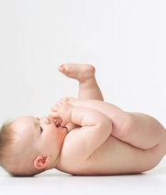
Inborn Skills
The Competent Newborn
Reflexes are responses that are inborn and do not have to be learned.
Newborns have reflexes to ensure that they will be fed.
The rooting reflex--when something touches a newborn’s cheek, the infant turns toward that side with an open mouth.
The sucking reflex can be triggered by a fingertip.
Crying when hungry is the newborn talent of using just the right sounds to motivate parents to end the noise and feed the baby.
Notes:
Click to reveal bullets.
How do we conclude that these abilities are inborn?...because they are evident within hours of birth.
The rooting reflex triggers the baby to get in position for breastfeeding.

Slide 8
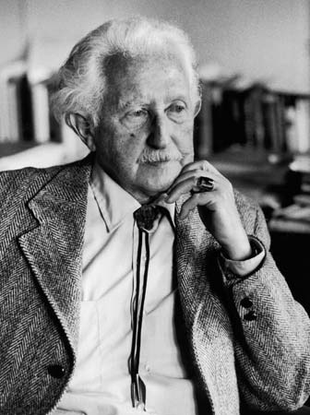
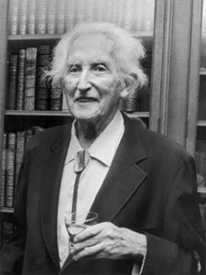
ERIKSON’S THEORY OF PSYCHOSOCIAL DEVELOPMENT

Slide 9
INTRODUCTION
-Erikson's stages of psychosocial development, as articulated by Erik Erikson, in collaboration with Joan Erikson, is a comprehensive psychoanalytic theory that identifies a series of eight stages, in which a healthy developing individual should pass through from infancy to late adulthood.
-Erikson believed that the achievements and failures of earlier stages influence later stages, whereas later stages modify and transform earlier ones.

Slide 10
Cont…
Psychosocial means it relates to one's psychological development and interaction with a social environment.

Slide 11
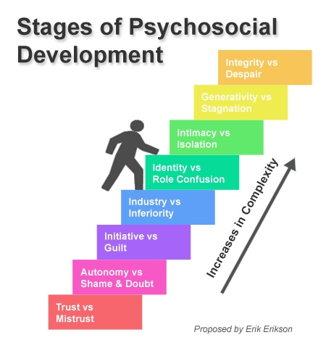

Slide 12
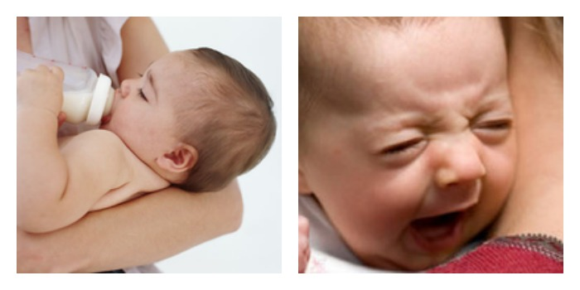
Trust vs. Mistrust
Stage | Infancy (Birth to 18 month)
Important Event | Feeding
Basic Conflict | Trust vs. Mistrust
Virtue | Hope
Positive Outcome | Sense of trust from environmental support
Negative Outcome | Mistrust, Fear, Concern regarding others

Slide 13
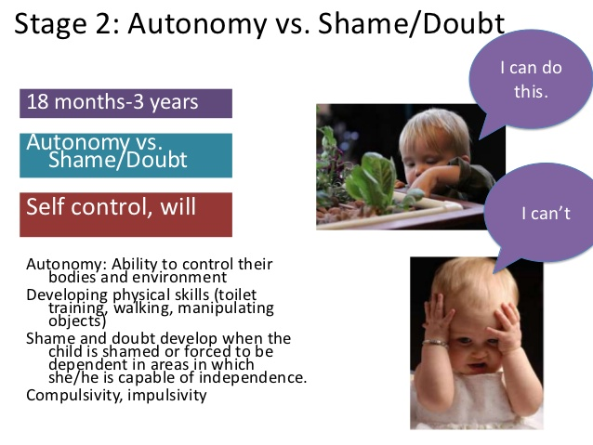
Autonomy vs. Shame and Doubt
Stage | Early Childhood (2 to 3 years)
Important Event | Toilet Training
Basic Conflict | Autonomy vs. Shame and Doubt
Virtue | Will
Positive Outcome | Sense of independence & personal control over physical skill
Negative Outcome | Shame & Doubt about self Lack of Independence

Slide 14


Initiative vs. Guilt
Stage | Preschool (3 to 5 years)
Important Event | Exploration
Basic Conflict | Initiative vs. Guilt
Virtue | Purpose
Positive Outcome | Sense of Purpose Discovery of ways to initiate actions
Negative Outcome | Feeling of disapproval Sense of Guilt

Slide 15


Industry vs. Inferiority
Stage | School Age (6 to 11 years)
Important Event | School
Basic Conflict | Industry vs. Inferiority
Virtue | Competence
Positive Outcome | Sense of Competence
Negative Outcome | Feeling of Inferiority No Sense of Mastery

Slide 16


Identity vs. Role Confusion
Stage | Adolescence (12 to 18 years)
Important Event | Social Relationship
Basic Conflict | Identity vs. Role Confusion
Virtue | Fidelity
Positive Outcome | Awareness of Uniqueness of Self Knowledge of role to be followed
Negative Outcome | Role Confusion Weak sense of Self

Slide 17


Intimacy vs. Isolation
Stage | Young Adulthood (19 to 40 years)
Important Event | Relationships
Basic Conflict | Intimacy vs. Isolation
Virtue | Love
Positive Outcome | Development of Loving, Sexual Relationship Close Friendship
Negative Outcome | Fear of Relationship with others Feeling of Loneliness & Isolation

Slide 18


Generativity vs. Stagnation
Stage | Middle Adulthood ( 40 to 65 years)
Important Event | Work and Parenthood
Basic Conflict | Generativity vs. Stagnation
Virtue | Care
Positive Outcome | Sense of Contribution to continuity of life Feeling of Usefulness & Accomplishment
Negative Outcome | Shallow involvement in the world

Slide 19


Integrity vs. Despair
Stage | Maturity ( 65 to Death)
Important Event | Reflection on life
Basic Conflict | Integrity vs. Despair
Virtue | Wisdom
Positive Outcome | Feeling of Wisdom
Negative Outcome | Regret over lost opportunities of life Feeling of Bitterness & Despair

Slide 20


